Slide 1
Demonstration of Robot-Assisted Automatic Conveyor System

Slide 2
Conveyor
A conveyor is an assembly of belts, chains, metal sheets, rollers, pulleys and motors and used in material handling, movement and packaging in various manufacturing units.

Slide 3
Types of conveyor systems
Aero-mechanical conveyors
Automotive conveyors
Belt conveyor
Belt-driven live roller conveyors
Bucket conveyor
Chain conveyor
Flexible conveyors
Gravity conveyors
Line shaft roller conveyor
Overhead I-beam conveyors
Plastic belt conveyors
Screw conveyor
Spiral conveyors
Vertical conveyors
Vibrating conveyors
Wire mesh conveyors

Slide 4
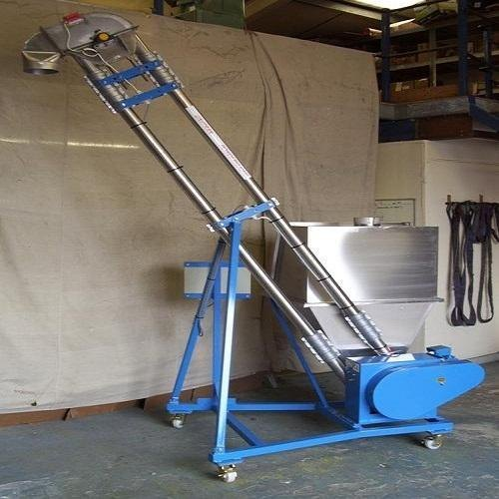
Aero-mechanical conveyors
Aero-mechanical conveyors

Slide 5
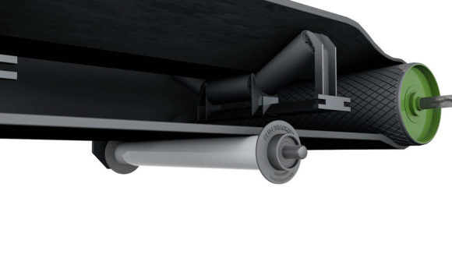
Belt conveyor and Belt-driven live roller conveyors
Belt conveyor
Belt-driven live roller conveyors

Slide 6
Bucket conveyor and Flexible conveyors
Bucket conveyor
Flexible conveyors

Slide 7
Gravity conveyors, Screw conveyor and Spiral conveyors
Gravity conveyor
Screw conveyors
Spiral conveyors

Slide 8
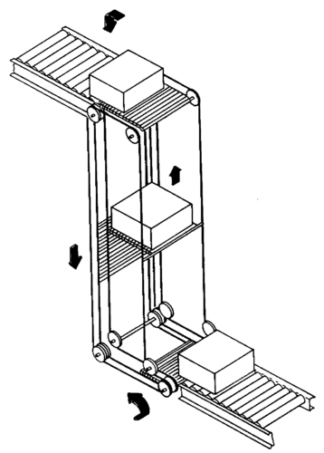
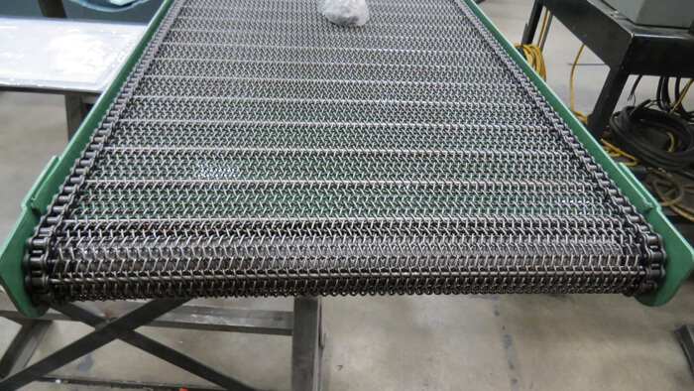
Vertical conveyors, Vibrating conveyors, Wire mesh conveyors
Vertical conveyor
Vibrating conveyors
Wire mesh conveyor

Slide 9
Advantages of conveyor systems
Safe transport of materials
Easy and fast installation compared to other material handling machines
Flexibility in handling materials of various shapes, sizes and weights
Flexibility in power source required to operate the system

Slide 10
Design and selection of conveyor systems
A few questions need to be asked before designing a conveyor system. The answer to these questions will help in choosing an appropriate system.
What are the goals and objectives for processing/assembly line?
What is the products that need to be moved?
What is the weight, size and packaging of the products?
What is the rate of production for the application (desired speed of the conveyors)?
How are the conveyors going to integrate with other equipment/machinery on the line?
Are there any product transfers involved?
What is the projected product flow of the application (sorting, accumulation, curves, inclines, declines etc.)?
What type of environment will the conveyor be operating in? If it will require cleaning, how extensive does that cleaning need to be?
Will robotics be integrated with the conveyor system?

Slide 11
Application of conveyors systems
Heavy manufacturing industry
Mining industry
Auto industry
Smartphone assembly industry
Food packaging industry
Pharmaceutical industry and may more.

